Slide 1
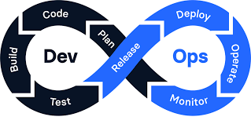
DevOps Fundamentals
Bridging the Gap Between Development and Operations

Slide 2
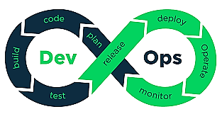
DevOps is a set of practices, cultural philosophies, and tools designed to increase an organization’s ability to deliver applications and services at high velocity. It combines software development (Dev) and IT operations (Ops) to shorten the development lifecycle and deliver high-quality software continuously.

Slide 3
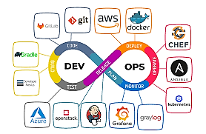

Slide 4
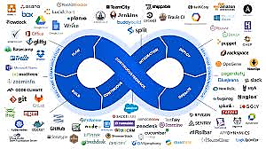

Slide 5

DevOps Roadmap

Slide 6


Slide 7
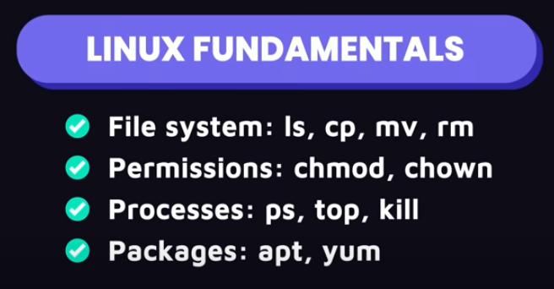

Slide 8
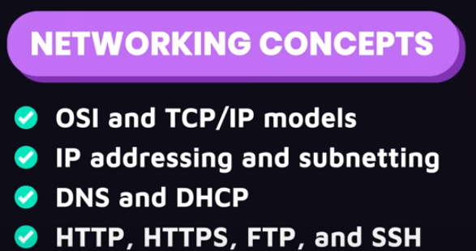

Slide 9
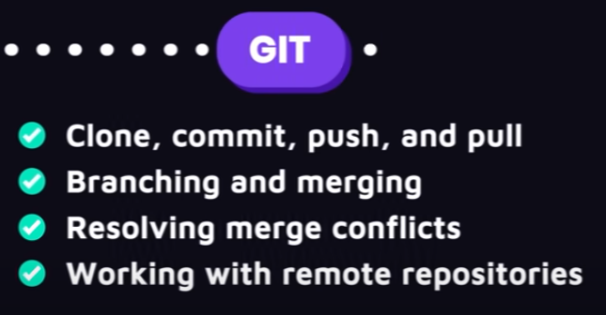

Slide 10
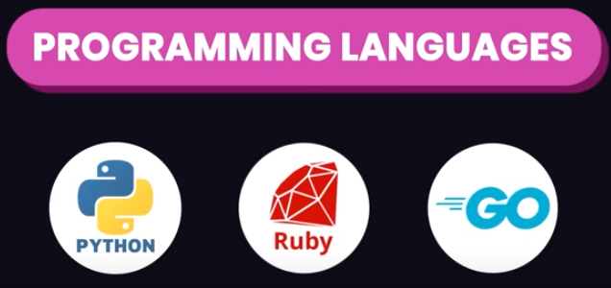

Slide 11
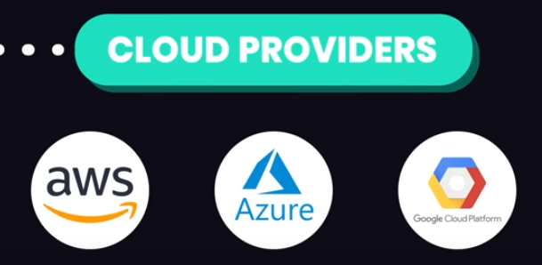

Slide 12
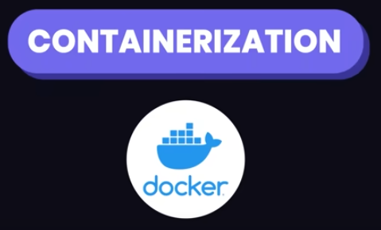

Slide 13
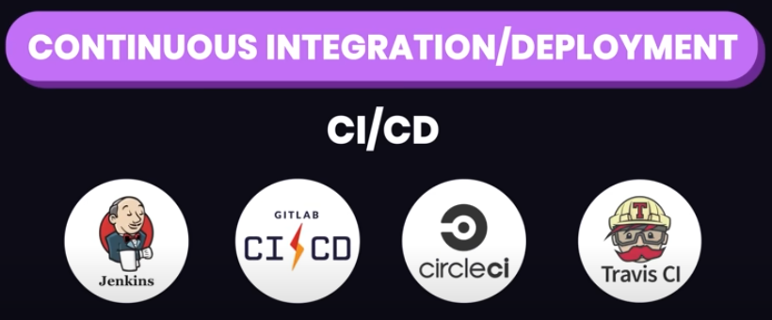

Slide 14


Slide 15
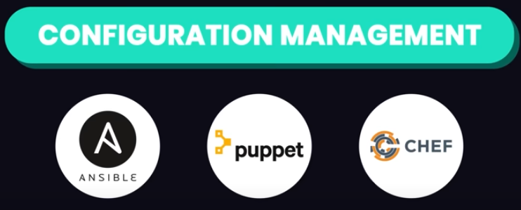

Slide 16
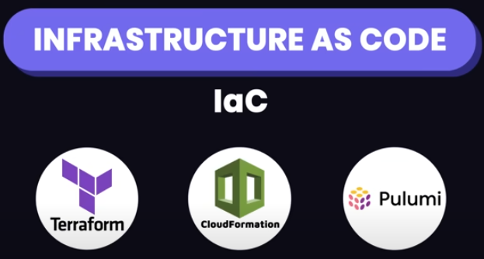

Slide 17


Slide 18
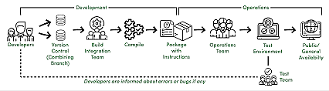
DevOps CI/CD Flow

Slide 19

DevOps Team

Slide 20
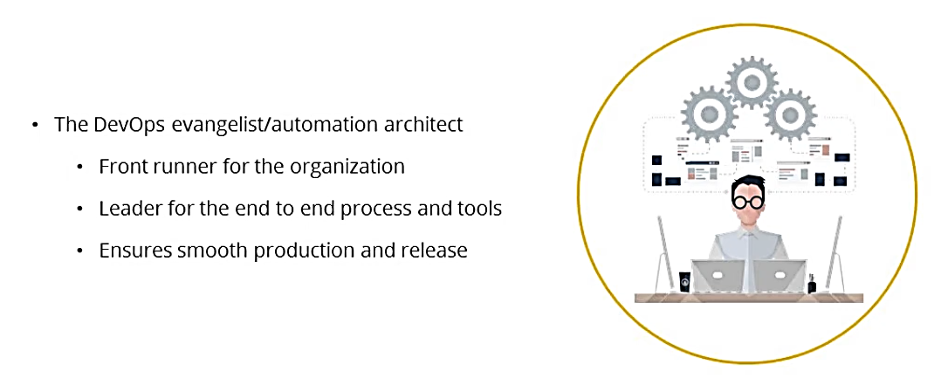

Slide 21
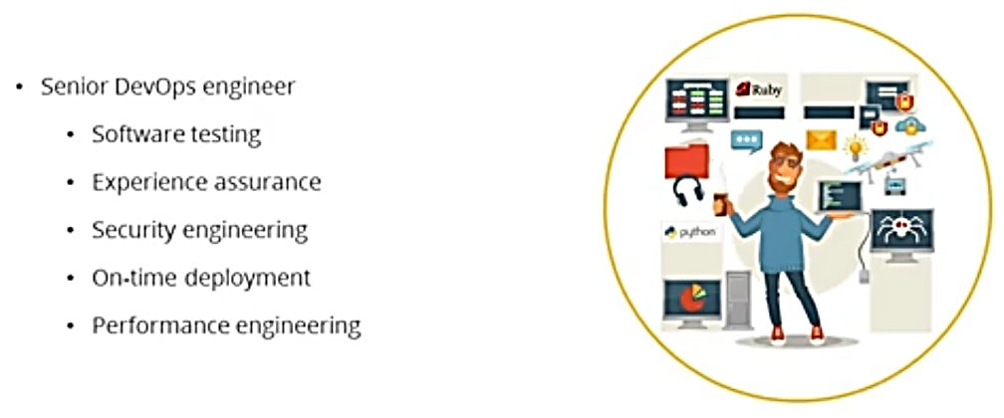

Slide 22
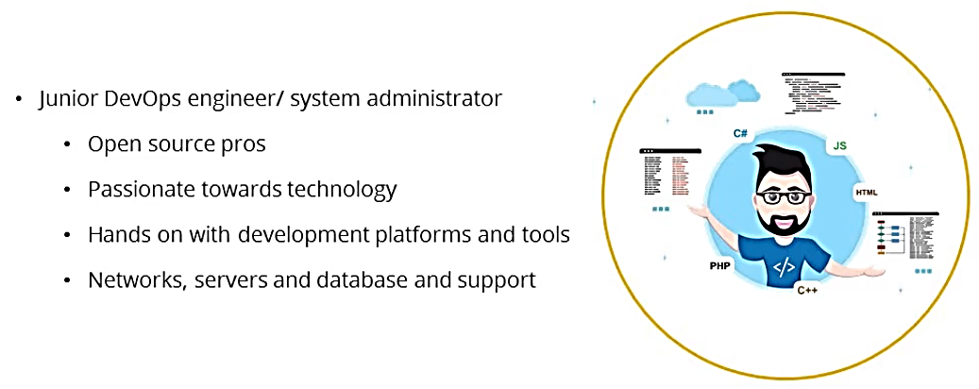

Slide 23
A Simple CI/CD Pipeline
A developer writes code and commits it to a version control system (e.g., Git)
A CI tool (like Jenkins, GitLab CI, or CircleCI) detects the commit and triggers an automated build.
Automated tests (unit tests, integration tests) are executed.
Once tests pass, the code is automatically deployed to a staging or production environment using CD tools (e.g., Kubernetes, Docker).
Post-deployment, monitoring tools (such as Prometheus, Grafana) track application performance.

